Slide 1
CSC4200/5200 – Computer Networking
Final Review - 1
Instructor: Susmit Shannigrahi
sshannigrahi@tntech.edu

Slide 2
Chapter 1: Fundamentals
Networking is ubiquitous
  What did you use it for today?
First things first:
  Terminology
  Basic tools
  What does it take to build an Internet?
Notes:
Ndn can help organizing the namespaces
Once that’s done, data discovery and provenance is
Straight forward
Retrieval, transparent failover, and specialized operations
In this work, we take a real access log and try to quantify NDN’s improvements to a climate
workflow

Slide 3
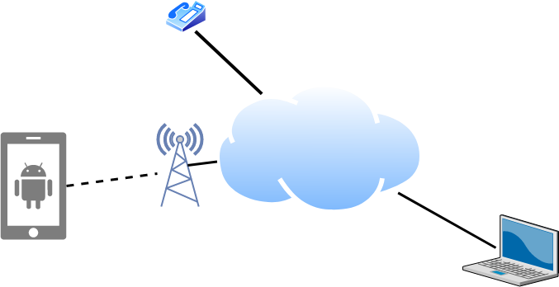
Links, Nodes, Cloud, Routers, Switches
Notes:
Ndn can help organizing the namespaces
Once that’s done, data discovery and provenance is
Straight forward
Retrieval, transparent failover, and specialized operations
In this work, we take a real access log and try to quantify NDN’s improvements to a climate
workflow

Slide 4
Client and Server
My laptop with a browser = client
  It requests a service
  Email, chat, video, youtube
A node running a program that serves the requests = server
  Runs a service
  Chat, video, messaging
A node can both be a client and a server
Notes:
Ndn can help organizing the namespaces
Once that’s done, data discovery and provenance is
Straight forward
Retrieval, transparent failover, and specialized operations
In this work, we take a real access log and try to quantify NDN’s improvements to a climate
workflow

Slide 5
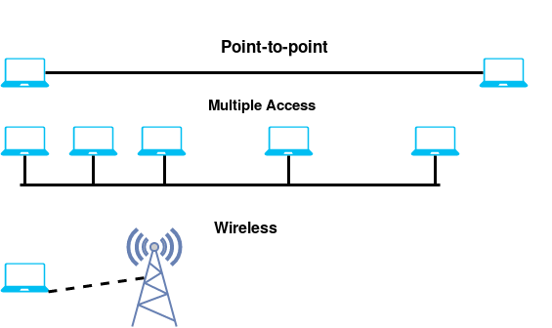
Connectivity
Point to Point
Multiple access
Wireless
Notes:
Ndn can help organizing the namespaces
Once that’s done, data discovery and provenance is
Straight forward
Retrieval, transparent failover, and specialized operations
In this work, we take a real access log and try to quantify NDN’s improvements to a climate
workflow

Slide 6
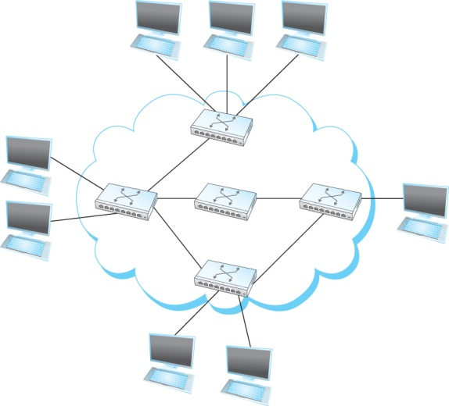
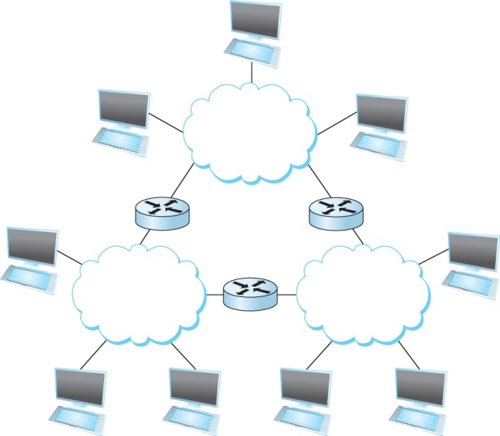
A Network and the Internet
Notes:
Ndn can help organizing the namespaces
Once that’s done, data discovery and provenance is
Straight forward
Retrieval, transparent failover, and specialized operations
In this work, we take a real access log and try to quantify NDN’s improvements to a climate
workflow

Slide 7
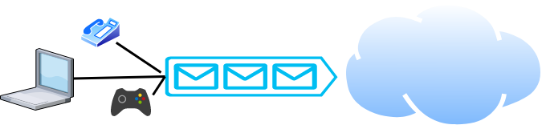
Packet Switching
Packets are low level components
Multiple kind of traffic with different requirements
  Gaming vs Phone
Dumb network – How do you ensure quality of service?
End points must be smart
Notes:
Ndn can help organizing the namespaces
Once that’s done, data discovery and provenance is
Straight forward
Retrieval, transparent failover, and specialized operations
In this work, we take a real access log and try to quantify NDN’s improvements to a climate
workflow

Slide 8
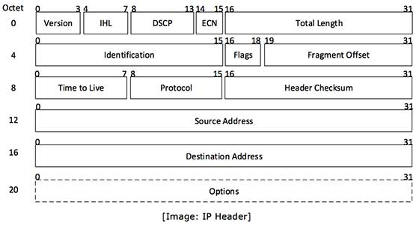
But What is a Packet?
Self-contained data unit
Has two parts (generally)
  Control information
  Payload
How do we transmit a dictionary?

Slide 9
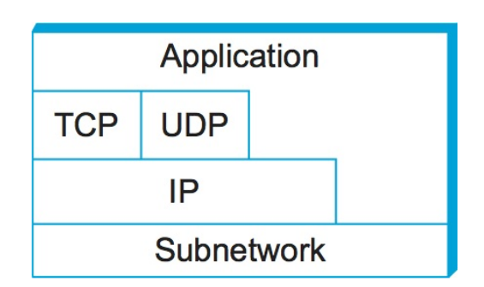
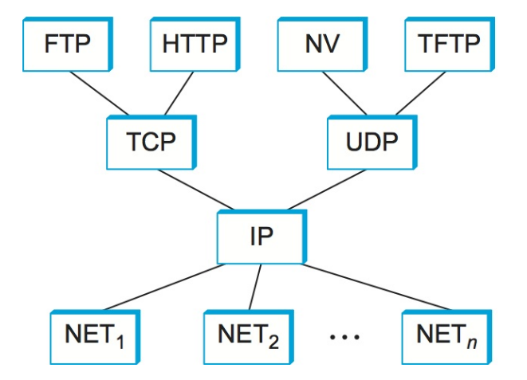
Network Layers
Use Service
Export Service
Makes it easier to divide functionality
Hides implementation details
What else?

Slide 10


IP Suite
We reject kings, presidents, and voting. We believe in rough consensus
and running code. (David Clark, IETF, July 1992)
wikipedia

Slide 11

Apps (HTTP)
Data
Apps (HTTP)
Segments
Transport (TCP/UDP)
Transport (TCP/UDP)
Network (IP)
Packets
Network (IP)
Link (Ethernet)
Frames
Link (Ethernet)
Ethernet Interface
Ethernet Interface
Bits (1010001)

Slide 12
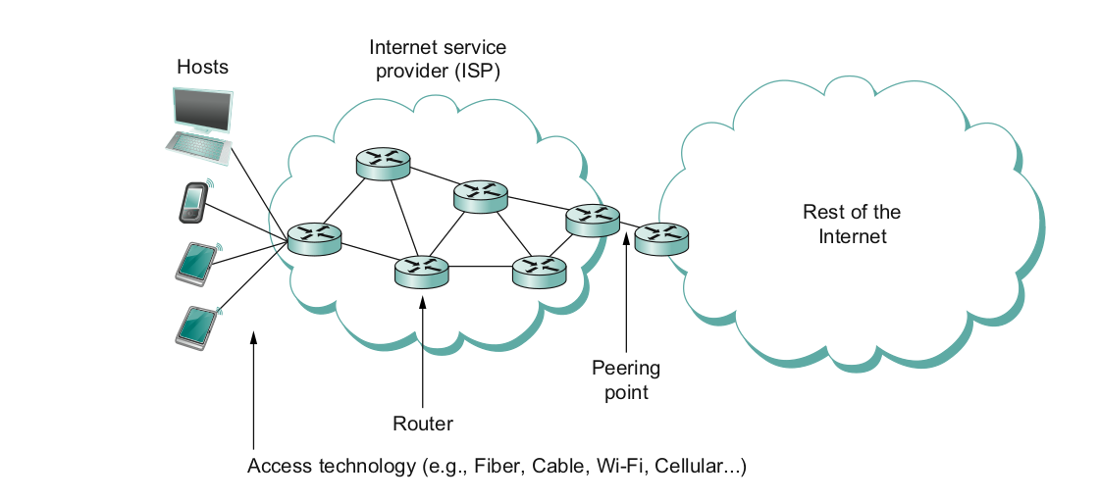
What does it take to create a link?
Common abstractions
  Why?

Slide 13
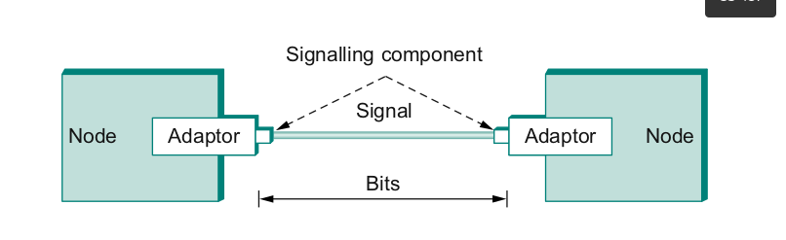
Packet to Low level Signals
Bit pattern - 0101001
  Must encode it into electrical signals and then decode it on the other end!

Slide 14
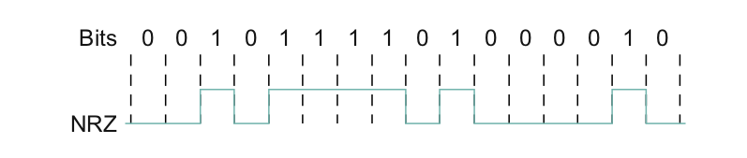
One easy way - NRZ
0 = low, 1= low
Problem if you have too many 0s or 1s in a row
  Baseline wander (read it in the book)

Slide 15
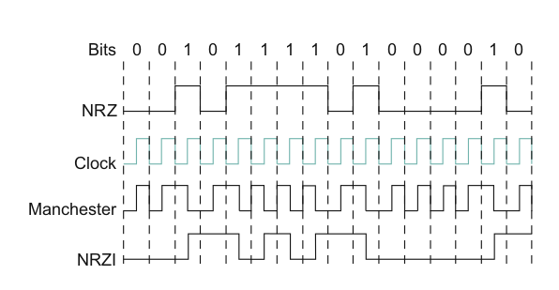
Other ways – NRZI/ Manchester Encoding
NRZI – 1=transition, 0= Don’t
Machester encoding – XOR of clock + NRZ data

Slide 16
Apps (HTTP)
Data
Apps (HTTP)
Segments
Transport (TCP/UDP)
Transport (TCP/UDP)
Network (IP)
Packets
Network (IP)
Link (Ethernet)
Frames
Link (Ethernet)
Ethernet Interface
Ethernet Interface
Bits (1010001)

Slide 17

Frames – bag of bits
Bits - between adaptors
Frames – between hosts (two computers)
  The job of adaptors is to find frames in a bit sequence
Frames are link layer protocols
Notes:
Ndn can help organizing the namespaces
Once that’s done, data discovery and provenance is
Straight forward
Retrieval, transparent failover, and specialized operations
In this work, we take a real access log and try to quantify NDN’s improvements to a climate
workflow

Slide 18
Error Detection
Basic Idea of Error Detection
  To add redundant information to a frame that can be used to determine if errors have been introduced
0
1
0
1
0
0
0
1
0
1
1
1
Number of 1s
Odd 1s = Parity bit 0
Even 1s = Parity bit 1
Notes:
The University of Adelaide, School of Computer Science
December 2, 2019
Chapter 2 — Instructions: Language of the Computer

Slide 19
Reliable Delivery
Frames might get lost
  Too many bits lost
  Clock did not sync properly
  Error detected but the report got lost
Can we build links that does not have errors?
  Not possible
How about all those error correction stuff we learned?
  Can we add them to frames?
  We could, but think of the overhead
  What happens when the entire frame is lost?
Notes:
Ndn can help organizing the namespaces
Once that’s done, data discovery and provenance is
Straight forward
Retrieval, transparent failover, and specialized operations
In this work, we take a real access log and try to quantify NDN’s improvements to a climate
workflow

Slide 20
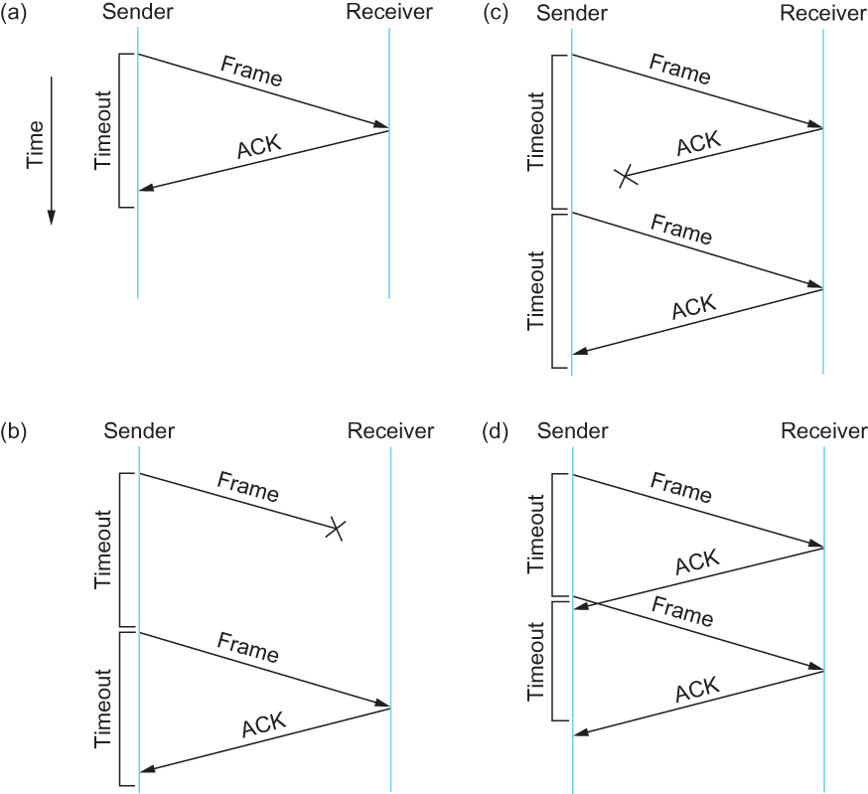
Stop and Wait
Sender sends a frame, sets a
timeout (e.g., 1 sec)
Receiver receives the frame,
sends an ACK
Sender
  sends the next frame on ACK
  retransmits the same frame if timeout happens
Spot the bugs in the protocol
Notes:
Ndn can help organizing the namespaces
Once that’s done, data discovery and provenance is
Straight forward
Retrieval, transparent failover, and specialized operations
In this work, we take a real access log and try to quantify NDN’s improvements to a climate
workflow

Slide 21
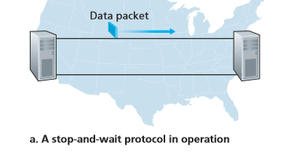
Stop and Wait – How does it perform?
Bandwidth (R)= 1Gbps
Packet size (L) = 1000 bytes
RTT = 30ms
T_{trans} = L/R = 8000bits/10⁹bits/sec = 8microsecond
T_{prop} = 15ms
Total Delay = 15.008 ms
Kurose/Ross
Notes:
Ndn can help organizing the namespaces
Once that’s done, data discovery and provenance is
Straight forward
Retrieval, transparent failover, and specialized operations
In this work, we take a real access log and try to quantify NDN’s improvements to a climate
workflow

Slide 22
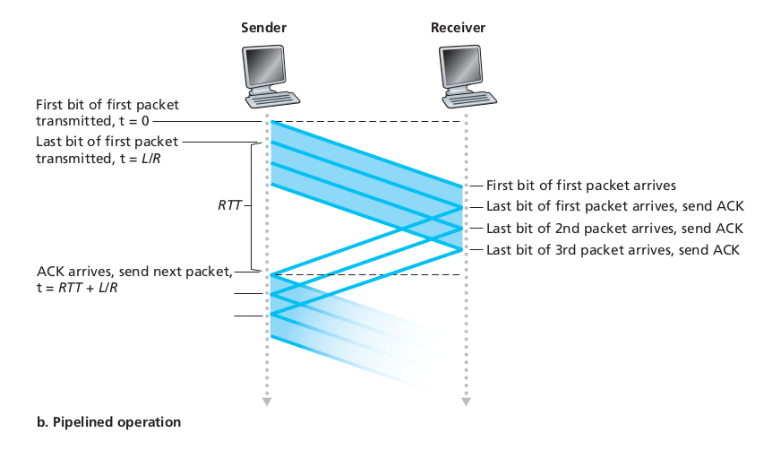
Sliding window to the rescue!
Utilization = 0.008*3/30.008 = 0.00079 (3 times increase)
Notes:
Ndn can help organizing the namespaces
Once that’s done, data discovery and provenance is
Straight forward
Retrieval, transparent failover, and specialized operations
In this work, we take a real access log and try to quantify NDN’s improvements to a climate
workflow

Slide 23
So far...
We have connected two machines using point to point wires
  Encoded bits
  Sent bits as Frames
  Caught and corrected errors
  Tuned efficiency and reliability using sliding window
What happens when there are more than two machines?
Notes:
Ndn can help organizing the namespaces
Once that’s done, data discovery and provenance is
Straight forward
Retrieval, transparent failover, and specialized operations
In this work, we take a real access log and try to quantify NDN’s improvements to a climate
workflow

Slide 24

AlohaNET
wikipedia
Notes:
Ndn can help organizing the namespaces
Once that’s done, data discovery and provenance is
Straight forward
Retrieval, transparent failover, and specialized operations
In this work, we take a real access log and try to quantify NDN’s improvements to a climate
workflow

Slide 25
Ethernet – Random Access
How to allow many adaptors to send frames over the wire?
  Random access
  When you have data – send at Full channel rate!
  No coordination needed.
If collision happens
  Detect
  Recover
  Retransmit
Notes:
Ndn can help organizing the namespaces
Once that’s done, data discovery and provenance is
Straight forward
Retrieval, transparent failover, and specialized operations
In this work, we take a real access log and try to quantify NDN’s improvements to a climate
workflow

Slide 26

Ethernet
Ethernet repeater
Notes:
The University of Adelaide, School of Computer Science
December 2, 2019
Chapter 2 — Instructions: Language of the Computer

Slide 27
CSMA/CD – Listen first, talk later!
CSMA – Carrier sense Multiple access
  Listen if anyone is transmitting
  Wait until carrier is free, do not interrupt others
  What is the carrier here?
CD – Collision Detection
  If you hear anyone while talking, collision, stop!
  Monitor signal strength at the adapter
  Higher than normal = collision
Random wait before retransmitting
  Why?
Notes:
Ndn can help organizing the namespaces
Once that’s done, data discovery and provenance is
Straight forward
Retrieval, transparent failover, and specialized operations
In this work, we take a real access log and try to quantify NDN’s improvements to a climate
workflow

Slide 28

CSMA/CD – Ethernet
CS – wait until idle
  Channel idle – trasmit
  Channel busy – wait
CD – listen while transmitting
  No collision: transmission successful
  Collission: abort, send jam signal (32bit special sequence)
Wait random time
  Try again
  After m^{th} collision,
  t = random(0,2^{m –} 1),
  Wait t*512 bit times before retry
Notes:
Ndn can help organizing the namespaces
Once that’s done, data discovery and provenance is
Straight forward
Retrieval, transparent failover, and specialized operations
In this work, we take a real access log and try to quantify NDN’s improvements to a climate
workflow

Slide 29

Ethernet Frame
SYNC- 7 bytes of 10101010
1 byte of 10101011
Payload
Upper layer protocol
(usually IP)
MAC ADDRESSES
Notes:
The University of Adelaide, School of Computer Science
December 2, 2019
Chapter 2 — Instructions: Language of the Computer

Slide 30
Wireless
Wireless links transmit electromagnetic signals
  Radio, microwave, infrared
Wireless links all share the same “wire” (so to speak)
  The challenge is to share it efficiently without unduly interfering with each other
  Most of this sharing is accomplished by dividing the “wire” along the dimensions of frequency and space
Exclusive use of a particular frequency in a particular geographic area may be allocated to an individual entity such as a corporation
Notes:
The University of Adelaide, School of Computer Science
December 2, 2019
Chapter 2 — Instructions: Language of the Computer

Slide 31




IEEE 802.11: Multiple Access
A
B
C
Avoid collisions: 2⁺ nodes transmitting at same time
802.11: CSMA - sense before transmitting
  don’t collide with ongoing transmission by other node
802.11: no collision detection!
  difficult to receive (sense collisions) when transmitting due to weak received signals (fading)
  can’t sense all collisions in any case: hidden terminal, fading
  goal: avoid collisions: CSMA/C(ollision)A(voidance)
A’s signal
strength
C’s signal
strength
space
C
B
Wireless, Mobile Networks
6-<number>
A

Slide 32



Collision Avoidance: RTS-CTS exchange
A
B
AP
RTS(B)
RTS(A)
reservation collision
RTS(A)
CTS(A)
CTS(A)
DATA (A)
defer
time
ACK(A)
ACK(A)
Wireless, Mobile Networks
6-<number>

Slide 33
So far...
we saw how to build a local network
How do we interconnect different types of networks to build a large network?
Notes:
Ndn can help organizing the namespaces
Once that’s done, data discovery and provenance is
Straight forward
Retrieval, transparent failover, and specialized operations
In this work, we take a real access log and try to quantify NDN’s improvements to a climate
workflow

Slide 34

Switching
Switch
  A mechanism to interconnect
  links to form a large network
  Forward frames
  Separate the collision domains
  Filter packets between LANs
  Connects two or more LAN segments - Bridging
LAN 1
Collision domain 1
LAN 2
Collision domain 2
Notes:
Ndn can help organizing the namespaces
Once that’s done, data discovery and provenance is
Straight forward
Retrieval, transparent failover, and specialized operations
In this work, we take a real access log and try to quantify NDN’s improvements to a climate
workflow

Slide 35
Switching Table
To decide how to forward a packet, a switch consults a forwarding table
Destination, Port
-------------------------------------
A 3
B 0
C 3
D 3
E 2
F 1
G 0
H 0
Forwarding Table for Switch 2
Notes:
Ndn can help organizing the namespaces
Once that’s done, data discovery and provenance is
Straight forward
Retrieval, transparent failover, and specialized operations
In this work, we take a real access log and try to quantify NDN’s improvements to a climate
workflow

Slide 36
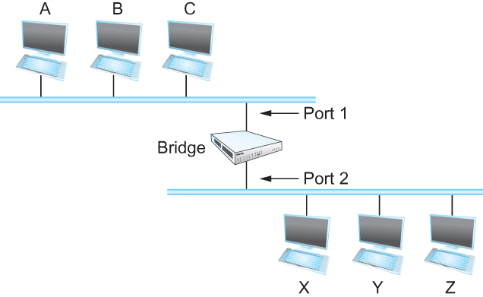
Bridges
Bridges and LAN Switches
    Class of switches that is used to forward packets between shared-media LANs such as Ethernets
  Known as LAN switches
  Referred to as Bridges
Suppose you have a pair of Ethernets that you want to interconnect
  One approach is put a repeater in between them, physical limitations
An alternative would be to put a node between the two Ethernets and have the node forward frames from one Ethernet to the other
  This node is called a Bridge
  A collection of LANs connected by one or more bridges is usually said to form an Extended LAN
Notes:
Ndn can help organizing the namespaces
Once that’s done, data discovery and provenance is
Straight forward
Retrieval, transparent failover, and specialized operations
In this work, we take a real access log and try to quantify NDN’s improvements to a climate
workflow

Slide 37
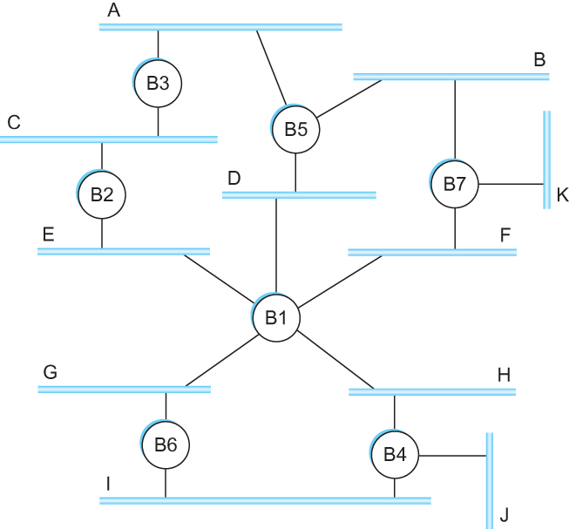
Flooding over bridges causes forwarding loops – Spanning tree
Spot the loop
Why?
Notes:
Ndn can help organizing the namespaces
Once that’s done, data discovery and provenance is
Straight forward
Retrieval, transparent failover, and specialized operations
In this work, we take a real access log and try to quantify NDN’s improvements to a climate
workflow

